Slide 1


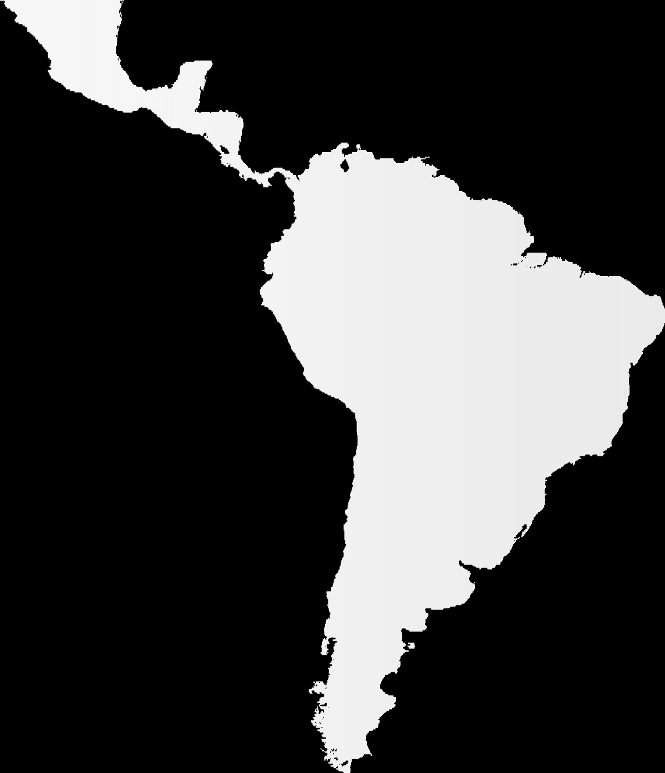








Automate large data extraction
M.Sc. Santiago Duarte
3- Oct -2022
Contact Information: (+57) 312 3073370
s.duarte@un-ihe.org
Delft, The Netherlands

Slide 2

Session content
Information in water resources
Data formats
Climate data sources
Data extraction outlines
Web Scrapping
  Weather web page example
  DHIME example
Python automate large data extraction
  GEE
  ECMFW
  Copernicus (Climate Data Store)

Slide 3

Why is important for you to automate large data extraction?

Slide 4
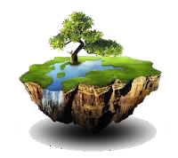


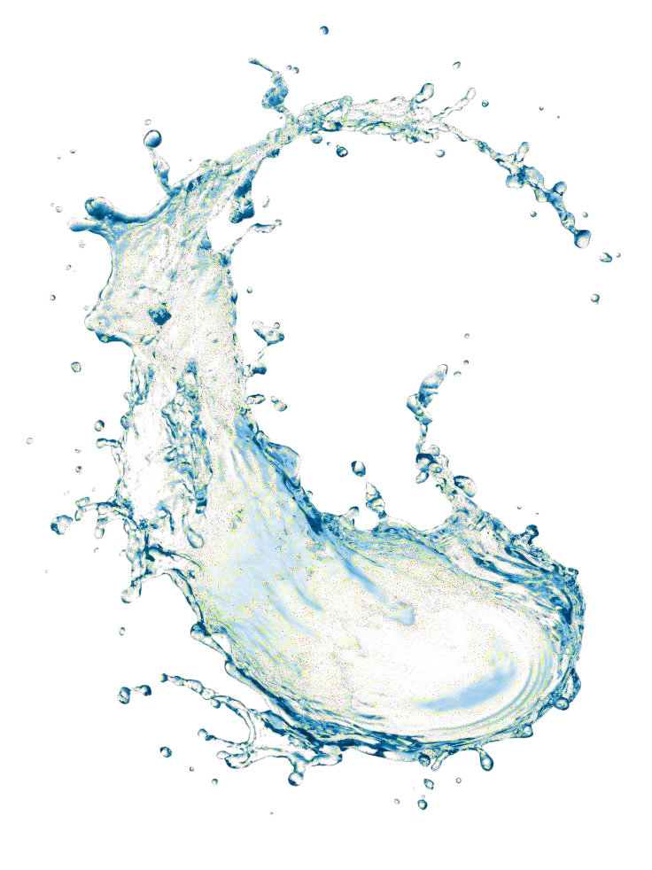
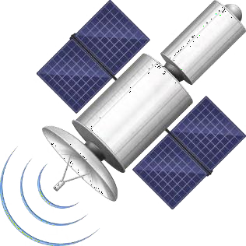
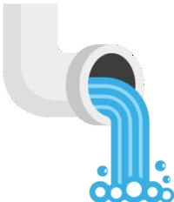

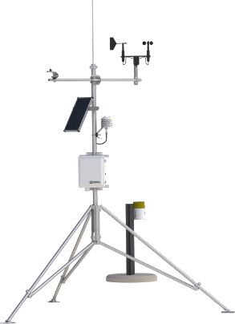

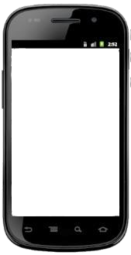
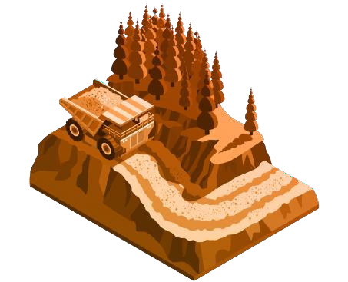

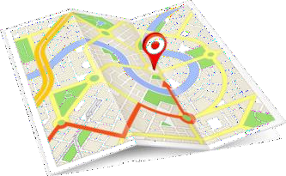


Information in Water Resources and Environment

Slide 5
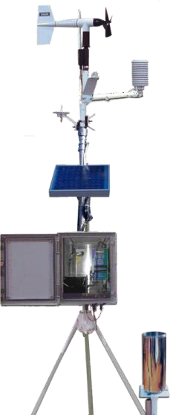
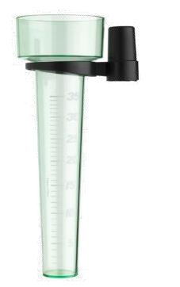
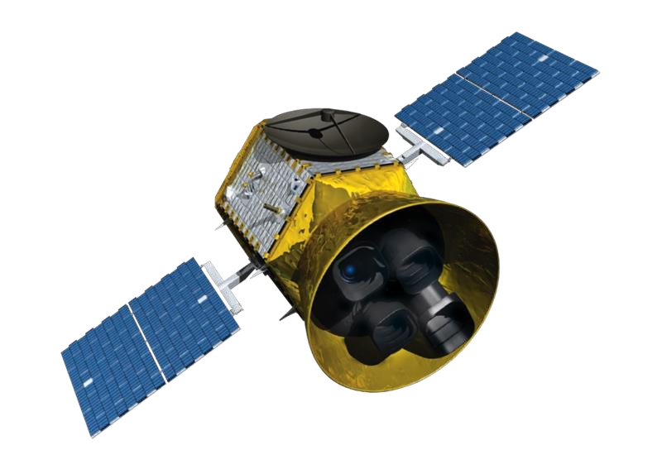
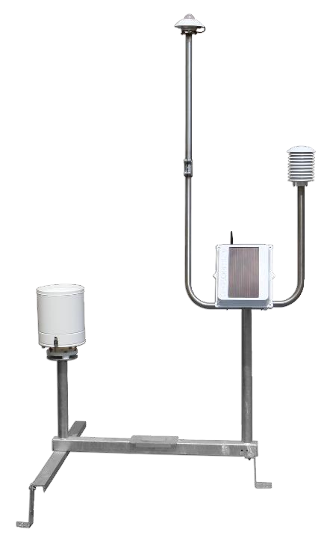
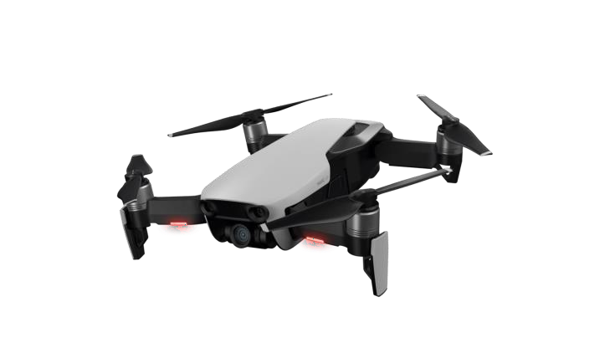
Climatic Data
In-situ stations
Satellite information,
remote sensors, drones

Slide 6
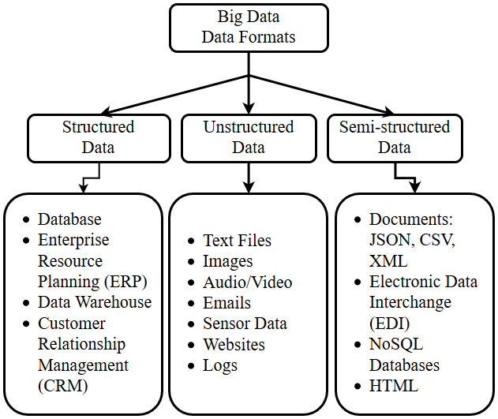
Data Formats
Comma Separated Values(CSV)
Network Common Data Form (NetCDF)
General Regularly-distributed Information in Binary form (GRIB)
JavaScript Object Notation (JSON)
Image file formats (Raster and Vector)

Slide 7
What is netCDF
The Network Common Data Form, or netCDF, is an interface to a library of data access functions for storing and retrieving data in the form of arrays. Current netCDF uses as base the HDF5 format.
The Hierarchical Data Format version 5 (HDF5), is an open source file format that supports large, complex, heterogeneous data.
HDF5 uses a "file directory" like structure that allows you to organize data within the file in many different structured ways, as you might do with files on your computer.

Slide 8
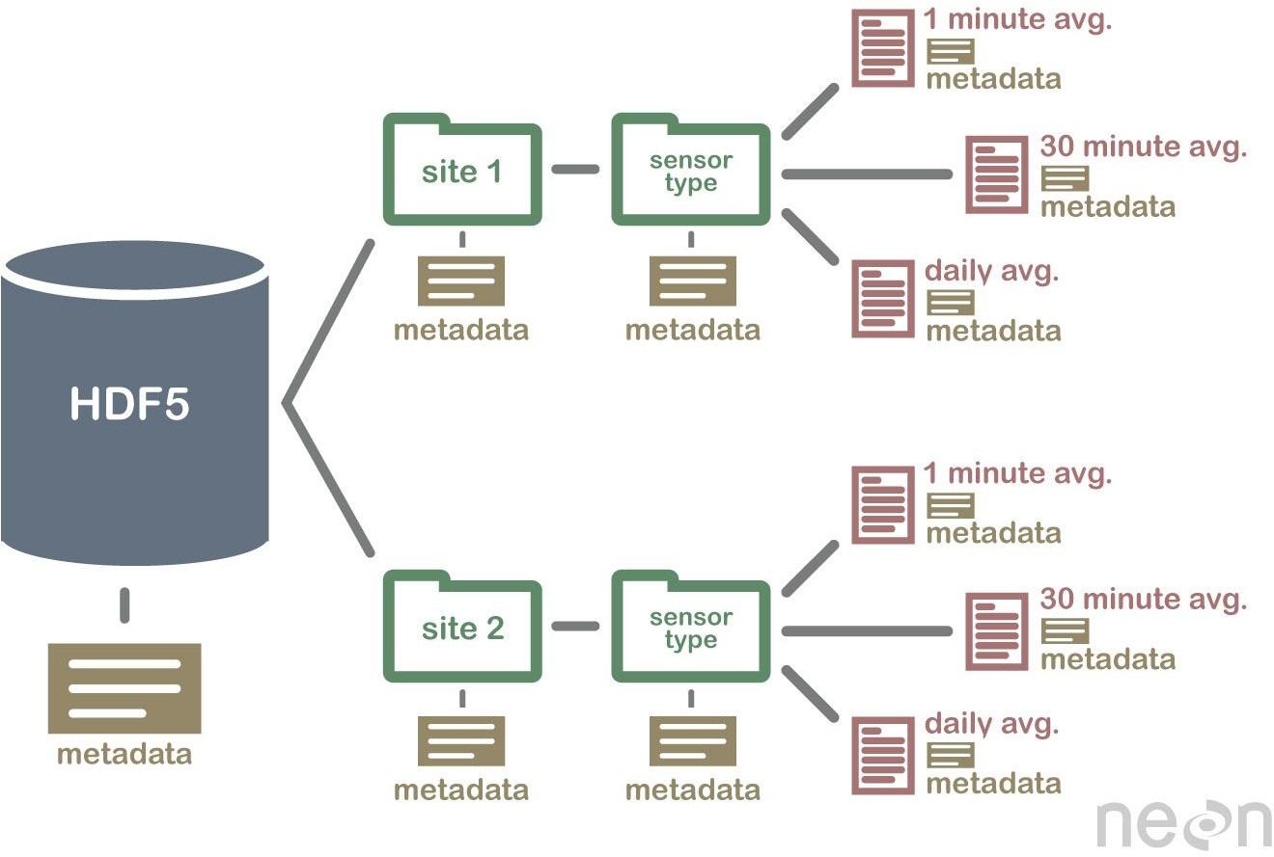
HDF5 hierarchical structure example

Slide 9

netCDF benefits
netCDF format supports efficient access to small subsets of large datasets.
Only the data that is required is kept in memory (RAM), making possible to manage large amounts of information.
I/O operations are concurrent (parallel access), so it is possible to have multiple processes accessing the file at the same file

Slide 10
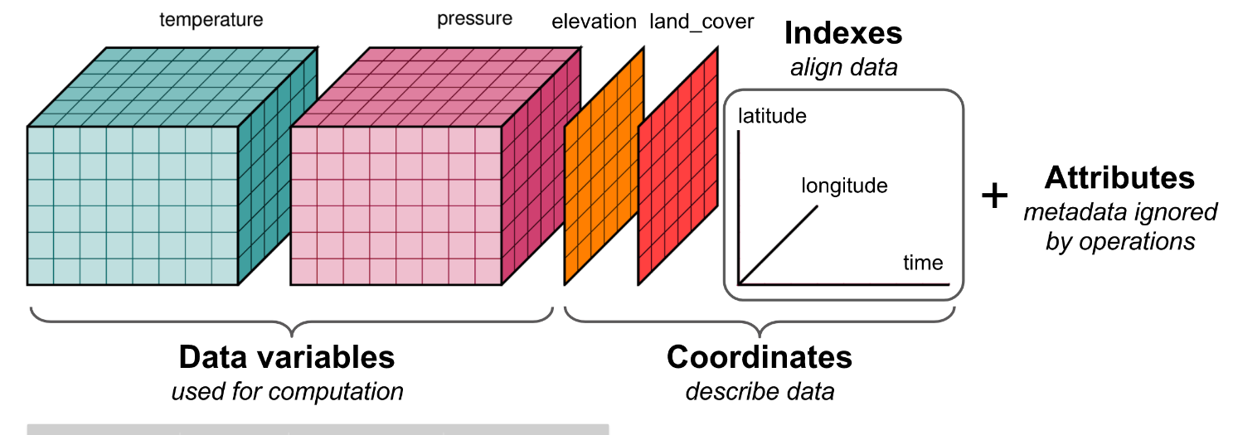
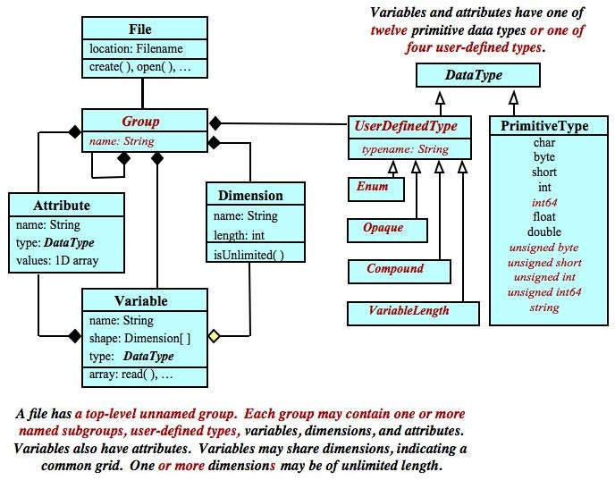
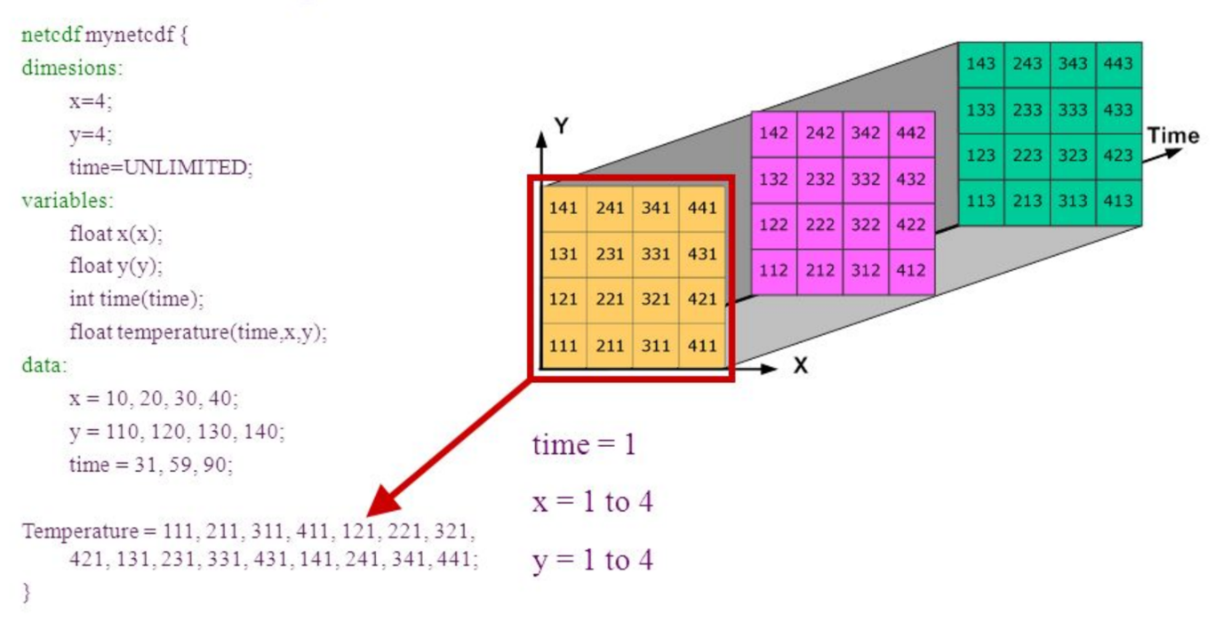
netCDF variables definition
https://colab.research.google.com/drive/1wWTXYjPnp4muQURbQj4IM1qOUybDhSJW?usp=sharing

Slide 11



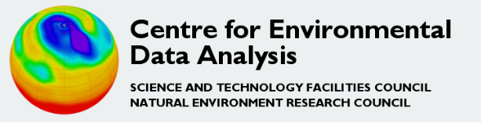



Climate Data Sources
Climate Data Store Copernicus
Climate Hazards Group InfraRed Precipitation with Station data (CHIRPS)
Climatology Lab
TerraClimate
Meteorological institutes and local organizations
Private/restricted databases

Slide 12
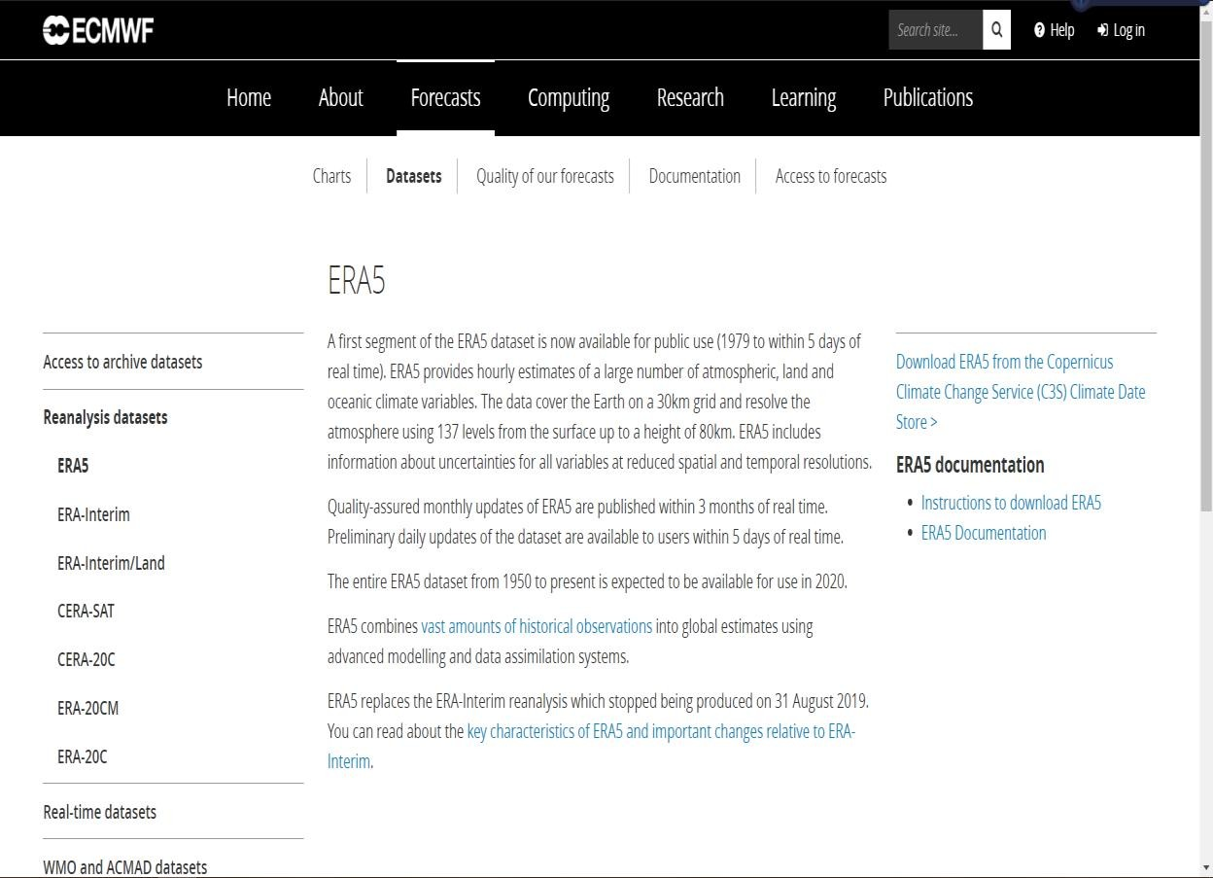
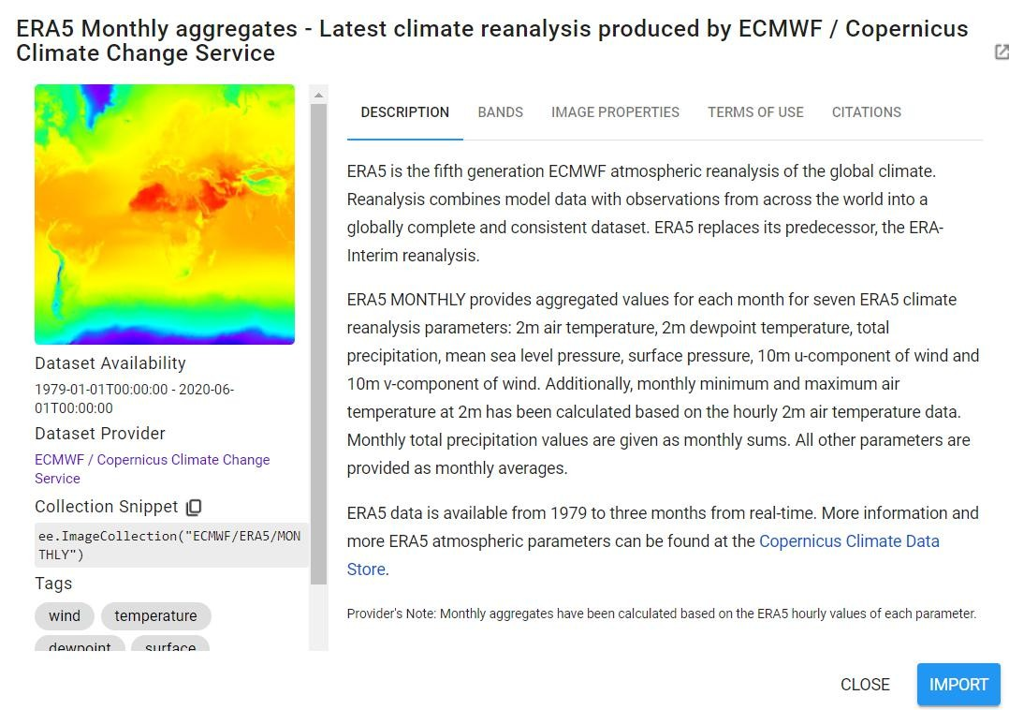
ERA Prodcuts
https://apps.ecmwf.int/datasets/data/interim-full-daily/levtype=sfc/

Slide 13
ERA 5
ERA 5 is the fifth generation of the ECMFW (European Center for Medium-Range Weather Forecasts) re-analysis data for global climate over the past few decades.
The re-analysis combines data from models with observations from around the world into a globally consistent and complete data set.
Data assimilation uses methods similar to numerical weather forecasting centers, where each 12-hour forecast is optimally combined for a higher estimate.
Information is currently available from 1950, with preliminary data between 1950 and 1978, and final data from 1979 onwards.

Slide 14
ERA 5
ERA5 provides hourly estimates for a large number of atmospheric, ocean wave, and land surface quantities.
An uncertainty estimation is sampled by an underlying set of 10 model ensembles at three-hourly intervals.
The data covers the Earth on a 30 km grid and resolves the atmosphere using 137 levels from the surface to a height of 80 km.

Slide 15
Large data extraction outline
Climatic Data Requirements:
Variables / parameters
Date range
Region (Extension)
Spatial resolution
Temporal resolution
Data source selection and registration:
Login user
Login password
Check for programmatically requests and retrieve data methods
*API (application programming interface)
Automation Scripts:
Select the programming language that suits your needs
Check the data download restrictions
Access with your login and API
Write the script and iterate for download large/multiple files
FTP (File Transfer Protocol) is a fast and convenient way to transfer files over the Internet. To make FTP work, you need a client (your machine) and a server (the machine to/from which you are putting/getting files).

Slide 16
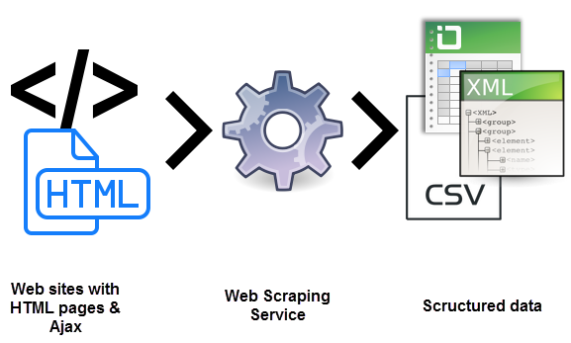


Web Scrapping
Web scraping (or data scraping) is a technique used to collect content and data from the internet. This data is usually saved in a local file so that it can be manipulated and analyzed as needed.

Slide 17
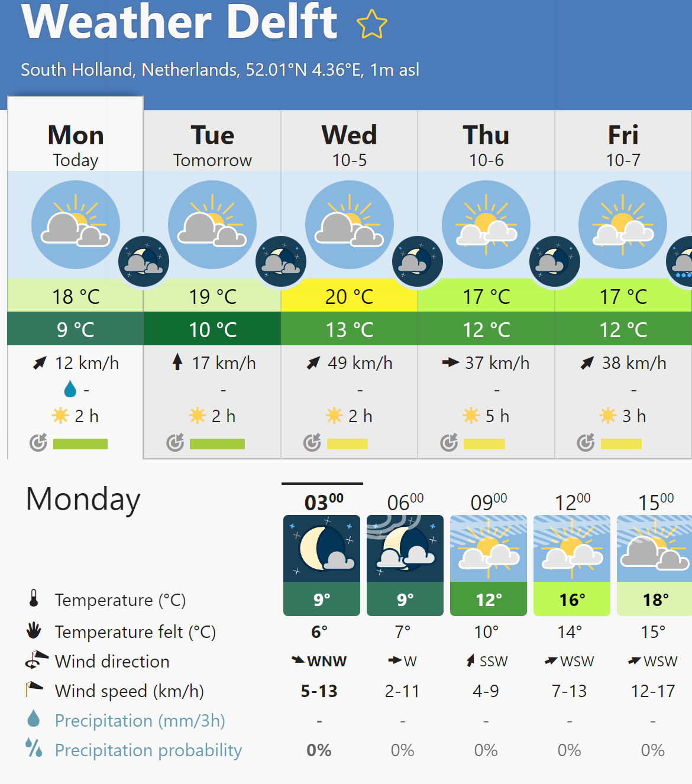
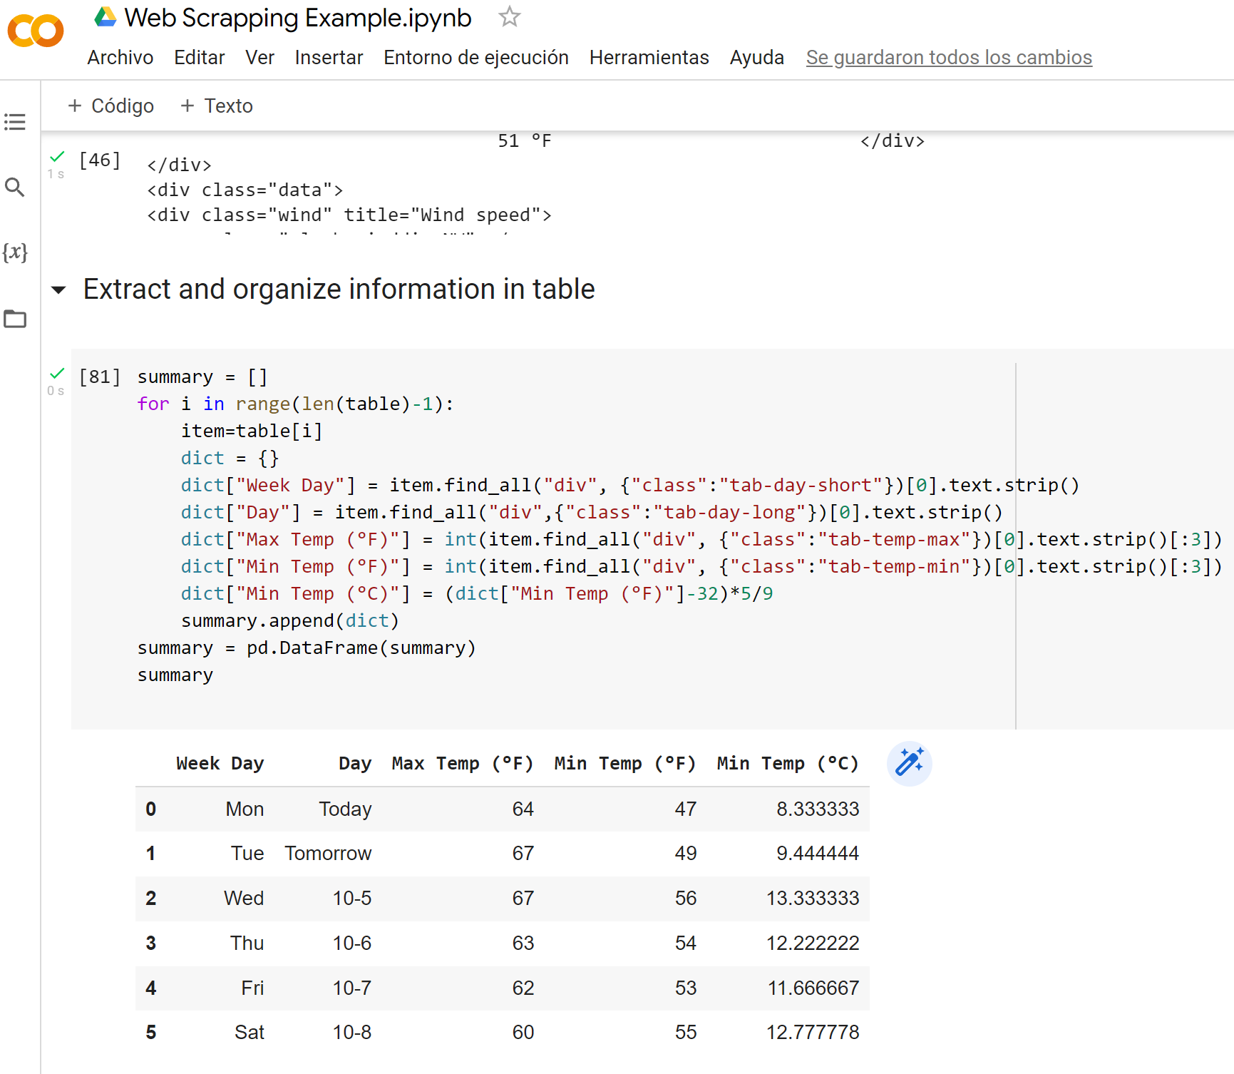
Weather web page example
https://colab.research.google.com/drive/1GeDoCAXkh6BaMViQFIzrQINeT_nVipIJ#scrollTo=v3Sojyb6XDmx

Slide 18
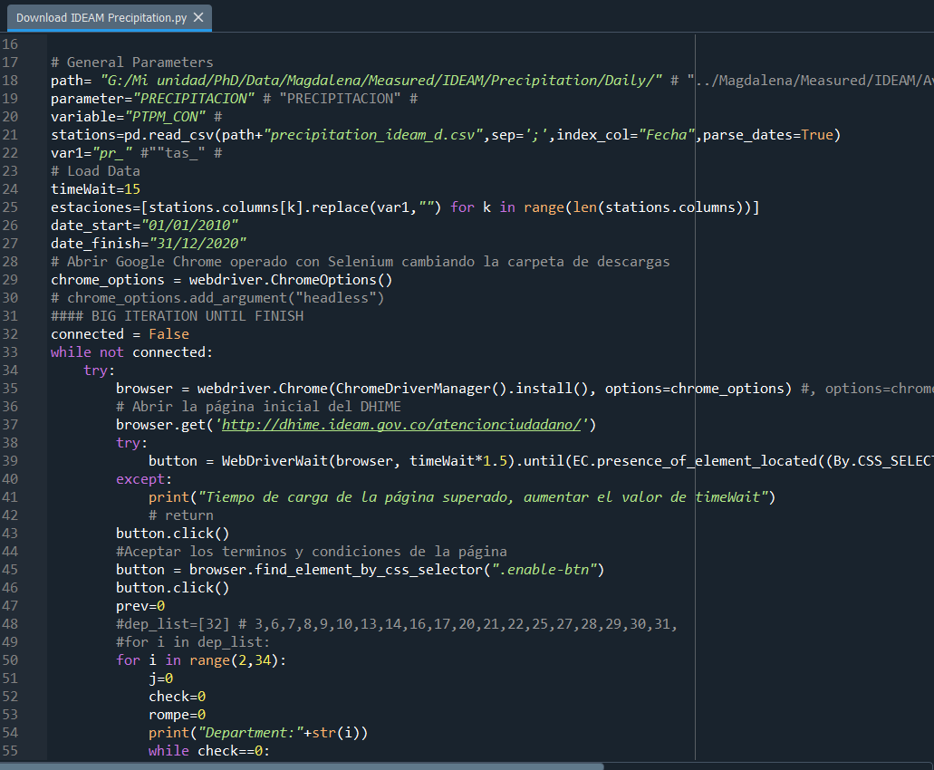
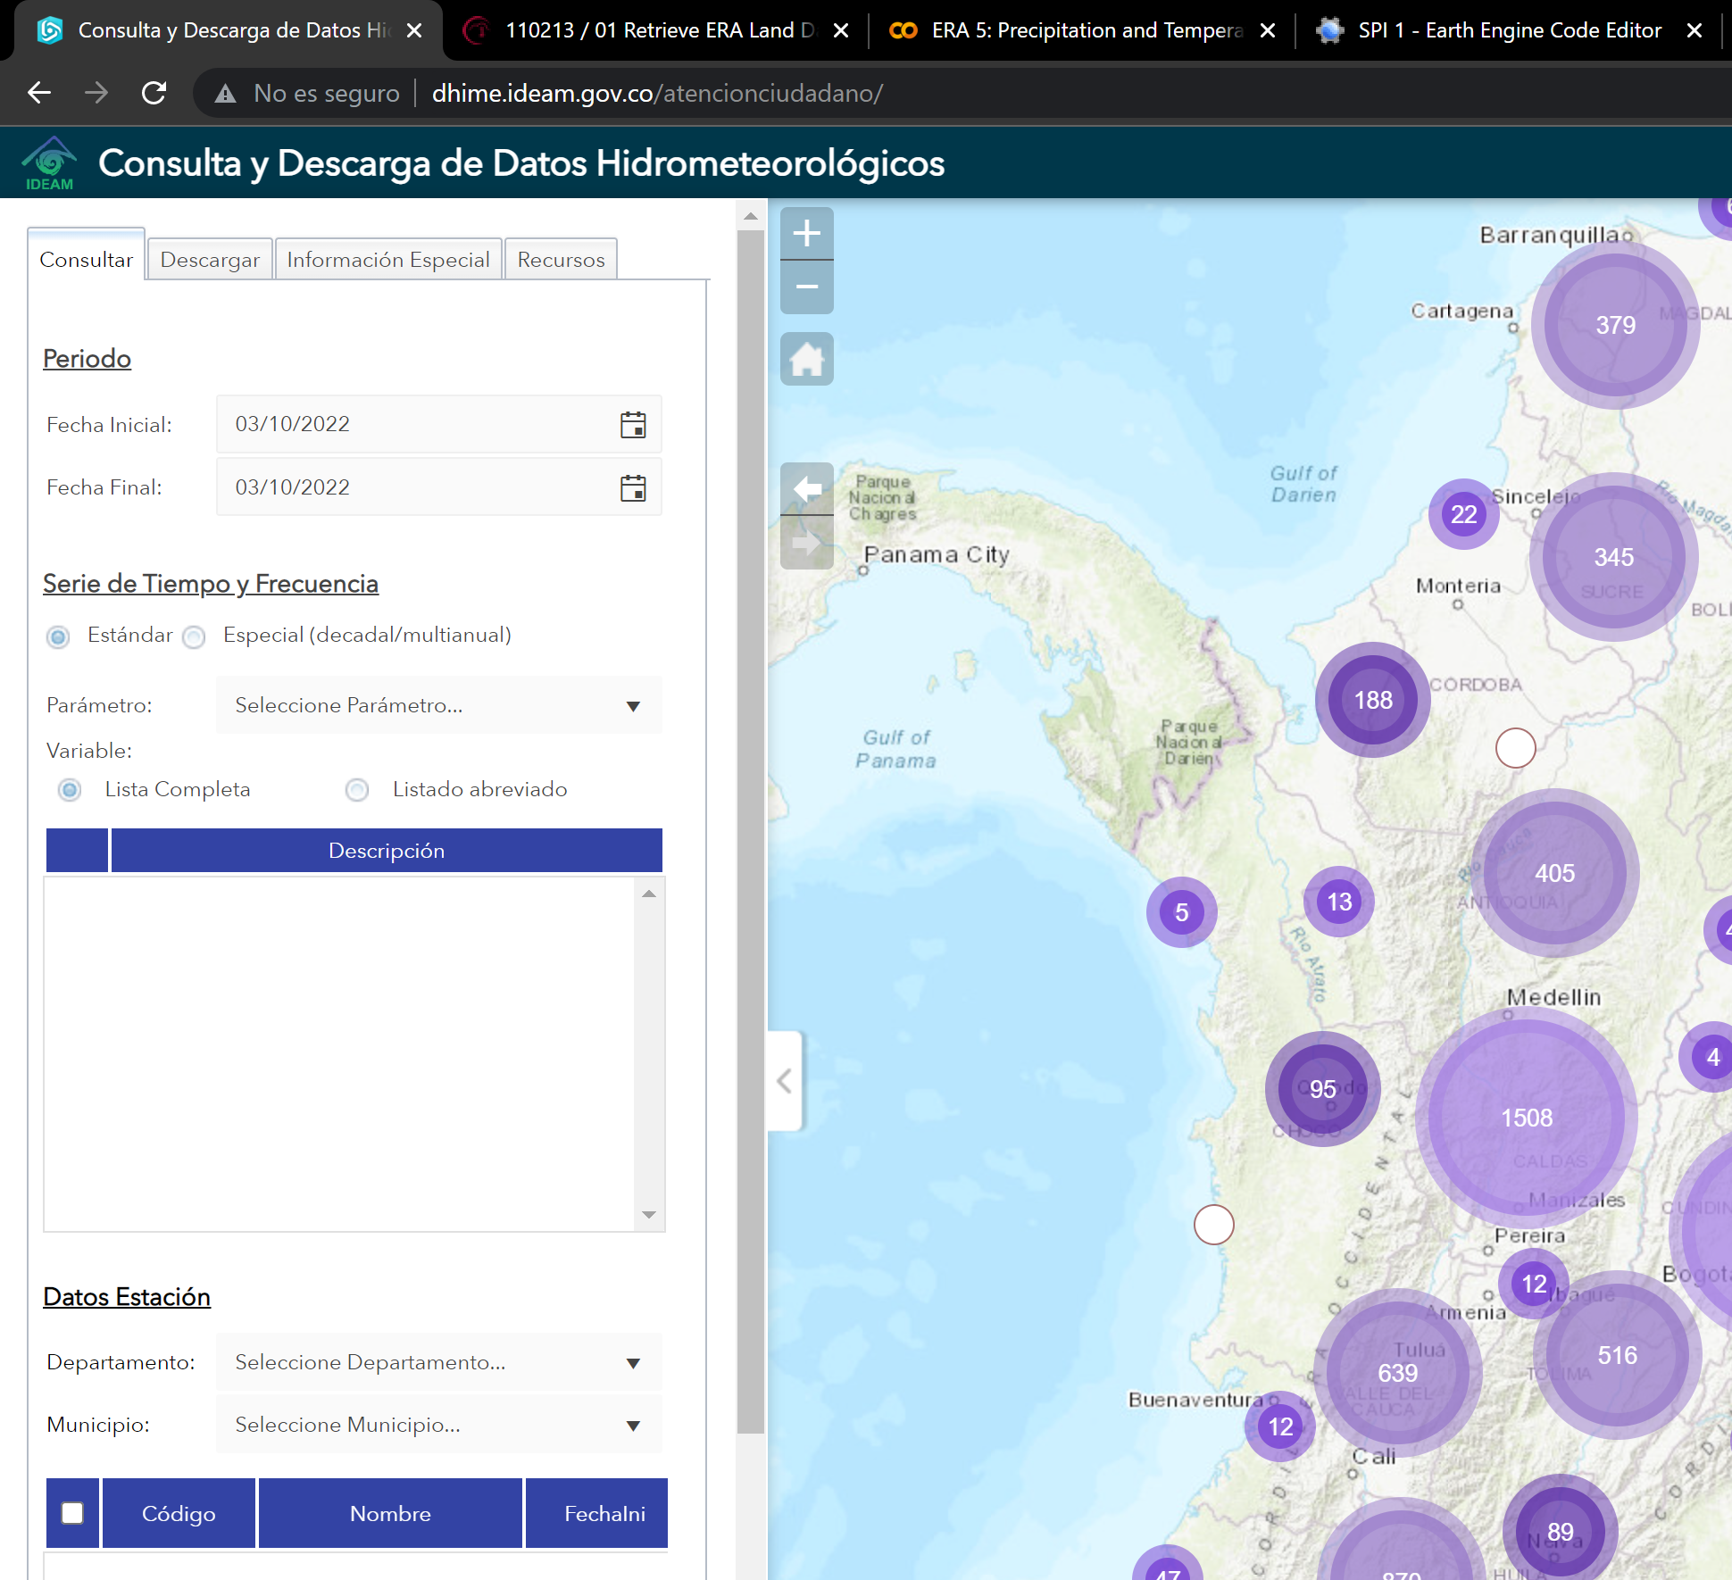
DHIME example
https://drive.google.com/file/d/1Ew988h4gfvC8ft1q7eSnyNkEQqECAo2A/view?usp=sharing

Slide 19
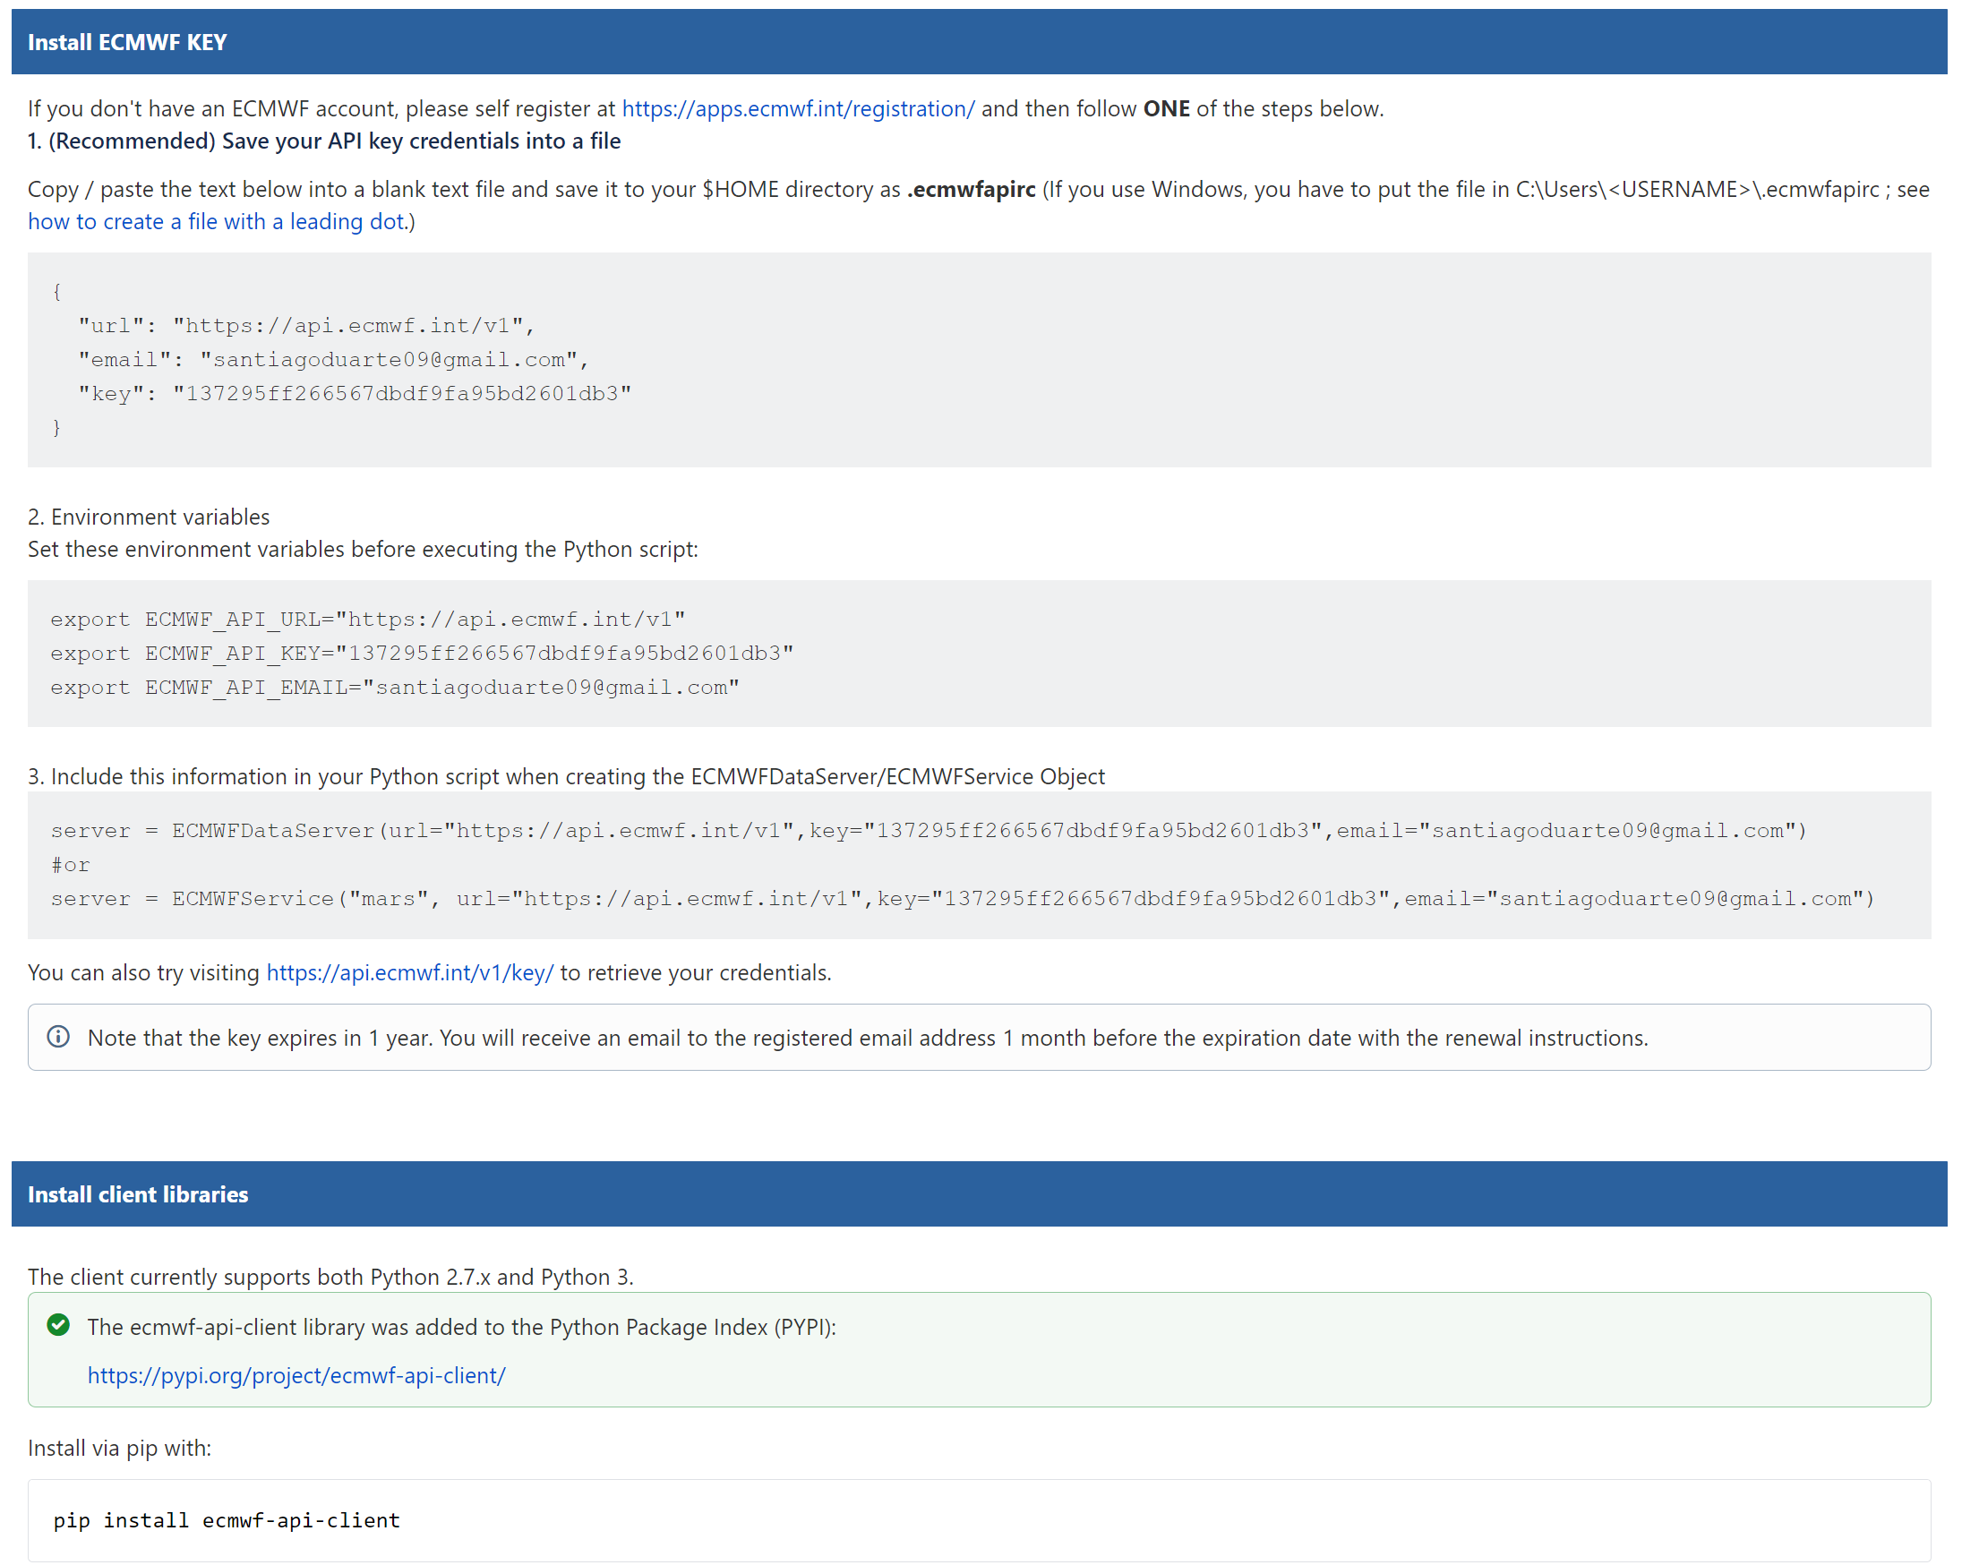
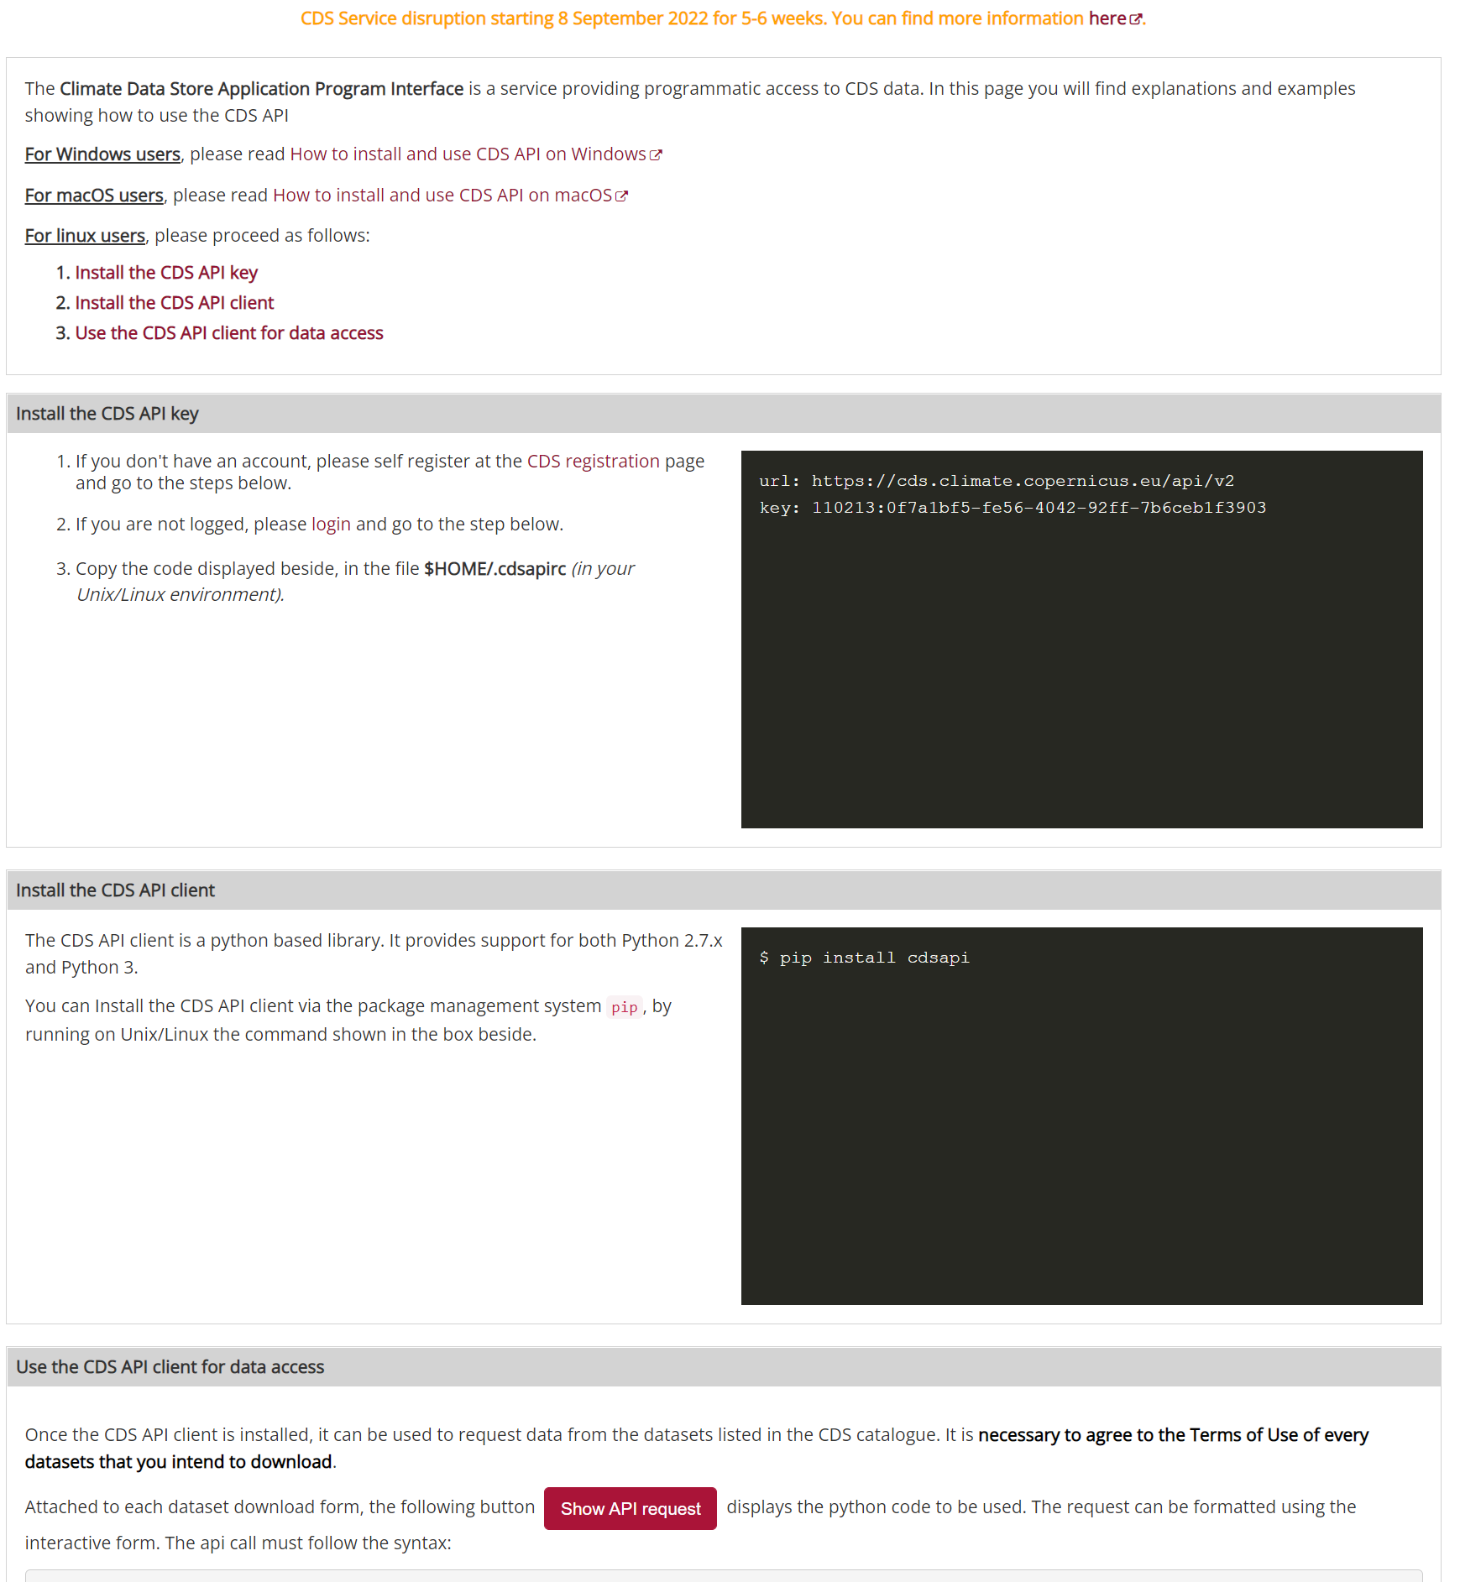
Python automate large data extraction

Slide 20
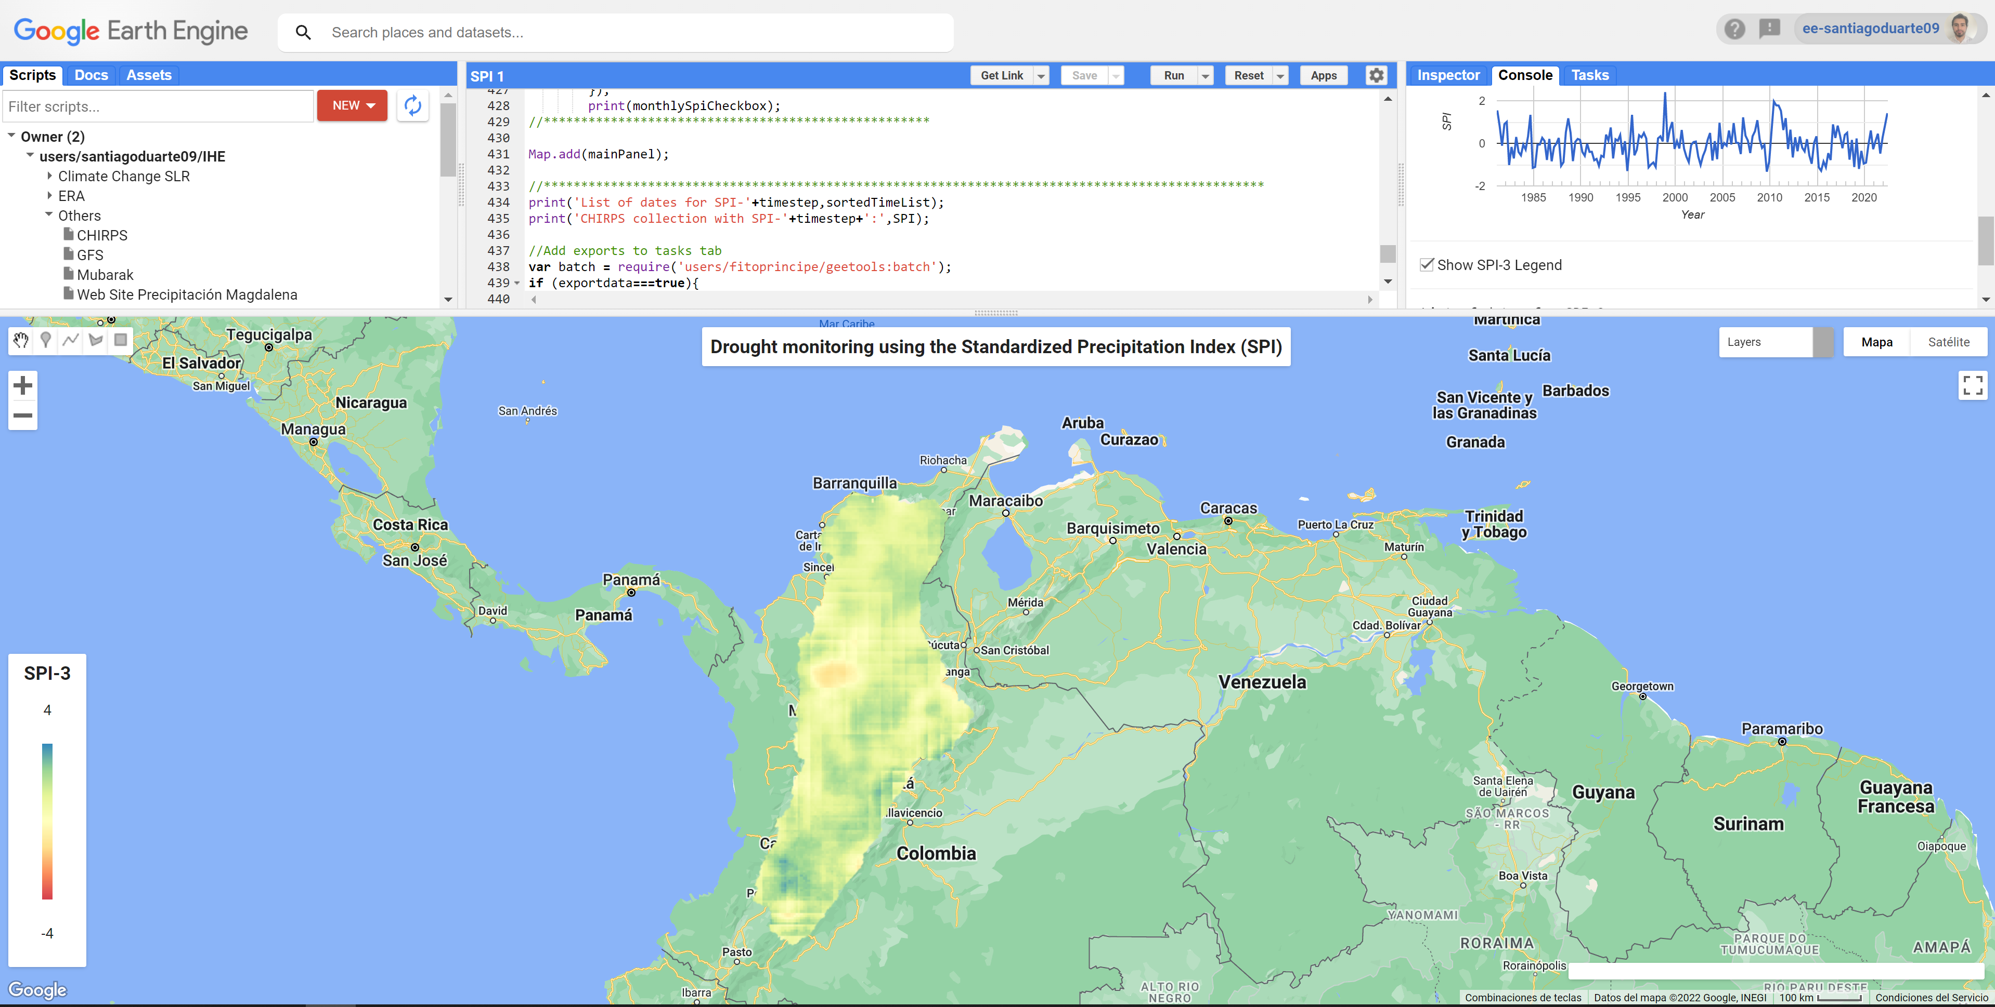

GEE SPI Example
SPI analysis using CHIRPS rainfall data and exporting to Drive
GOOGLE EARTH ENGINE
https://code.earthengine.google.com/677fc5e74536142791d1811503a3106b
https://santiagoduarte09.users.earthengine.app/view/era5-precipitacion

Slide 21


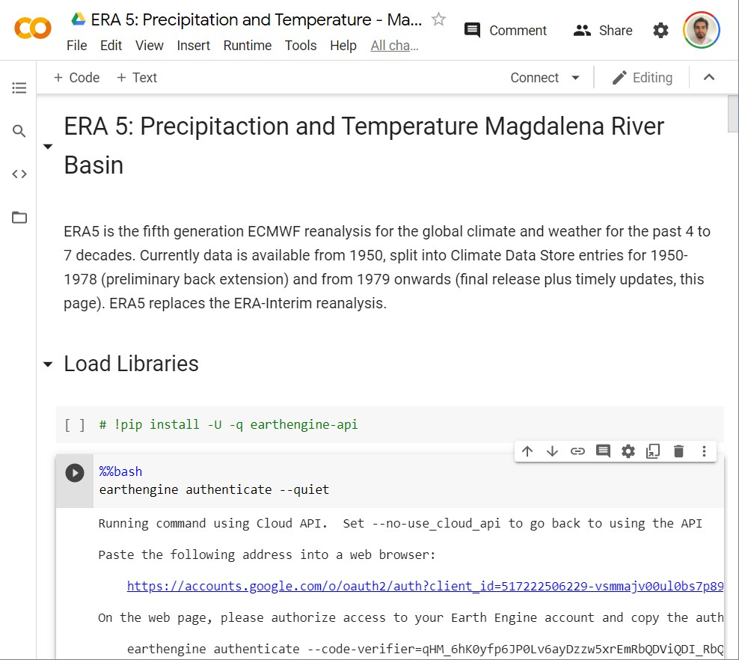

GOOGLE COLLAB
Tools to analyze and download the information from ERA5 using Google Earth Engine
https://colab.research.google.com/drive/1fxV50HUwGgpOys9bCLIfPCo0YK9Vvdmx?usp=sharing

Slide 22
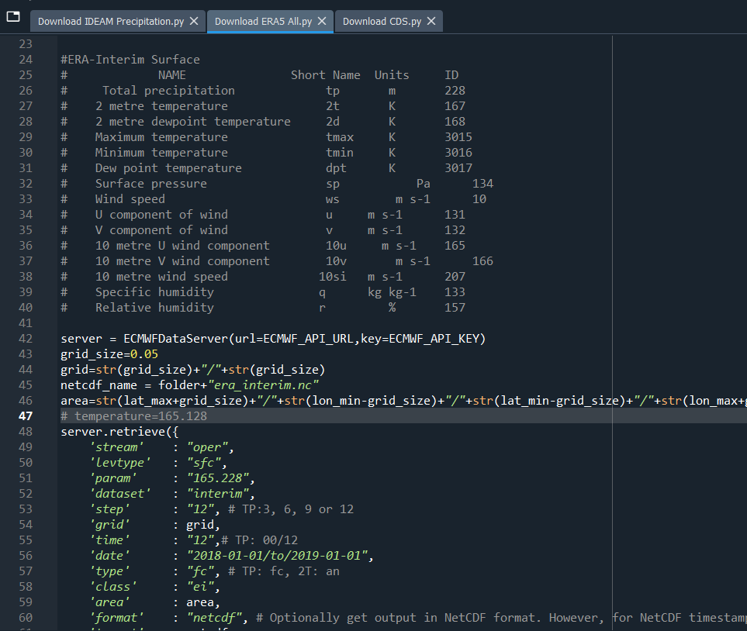
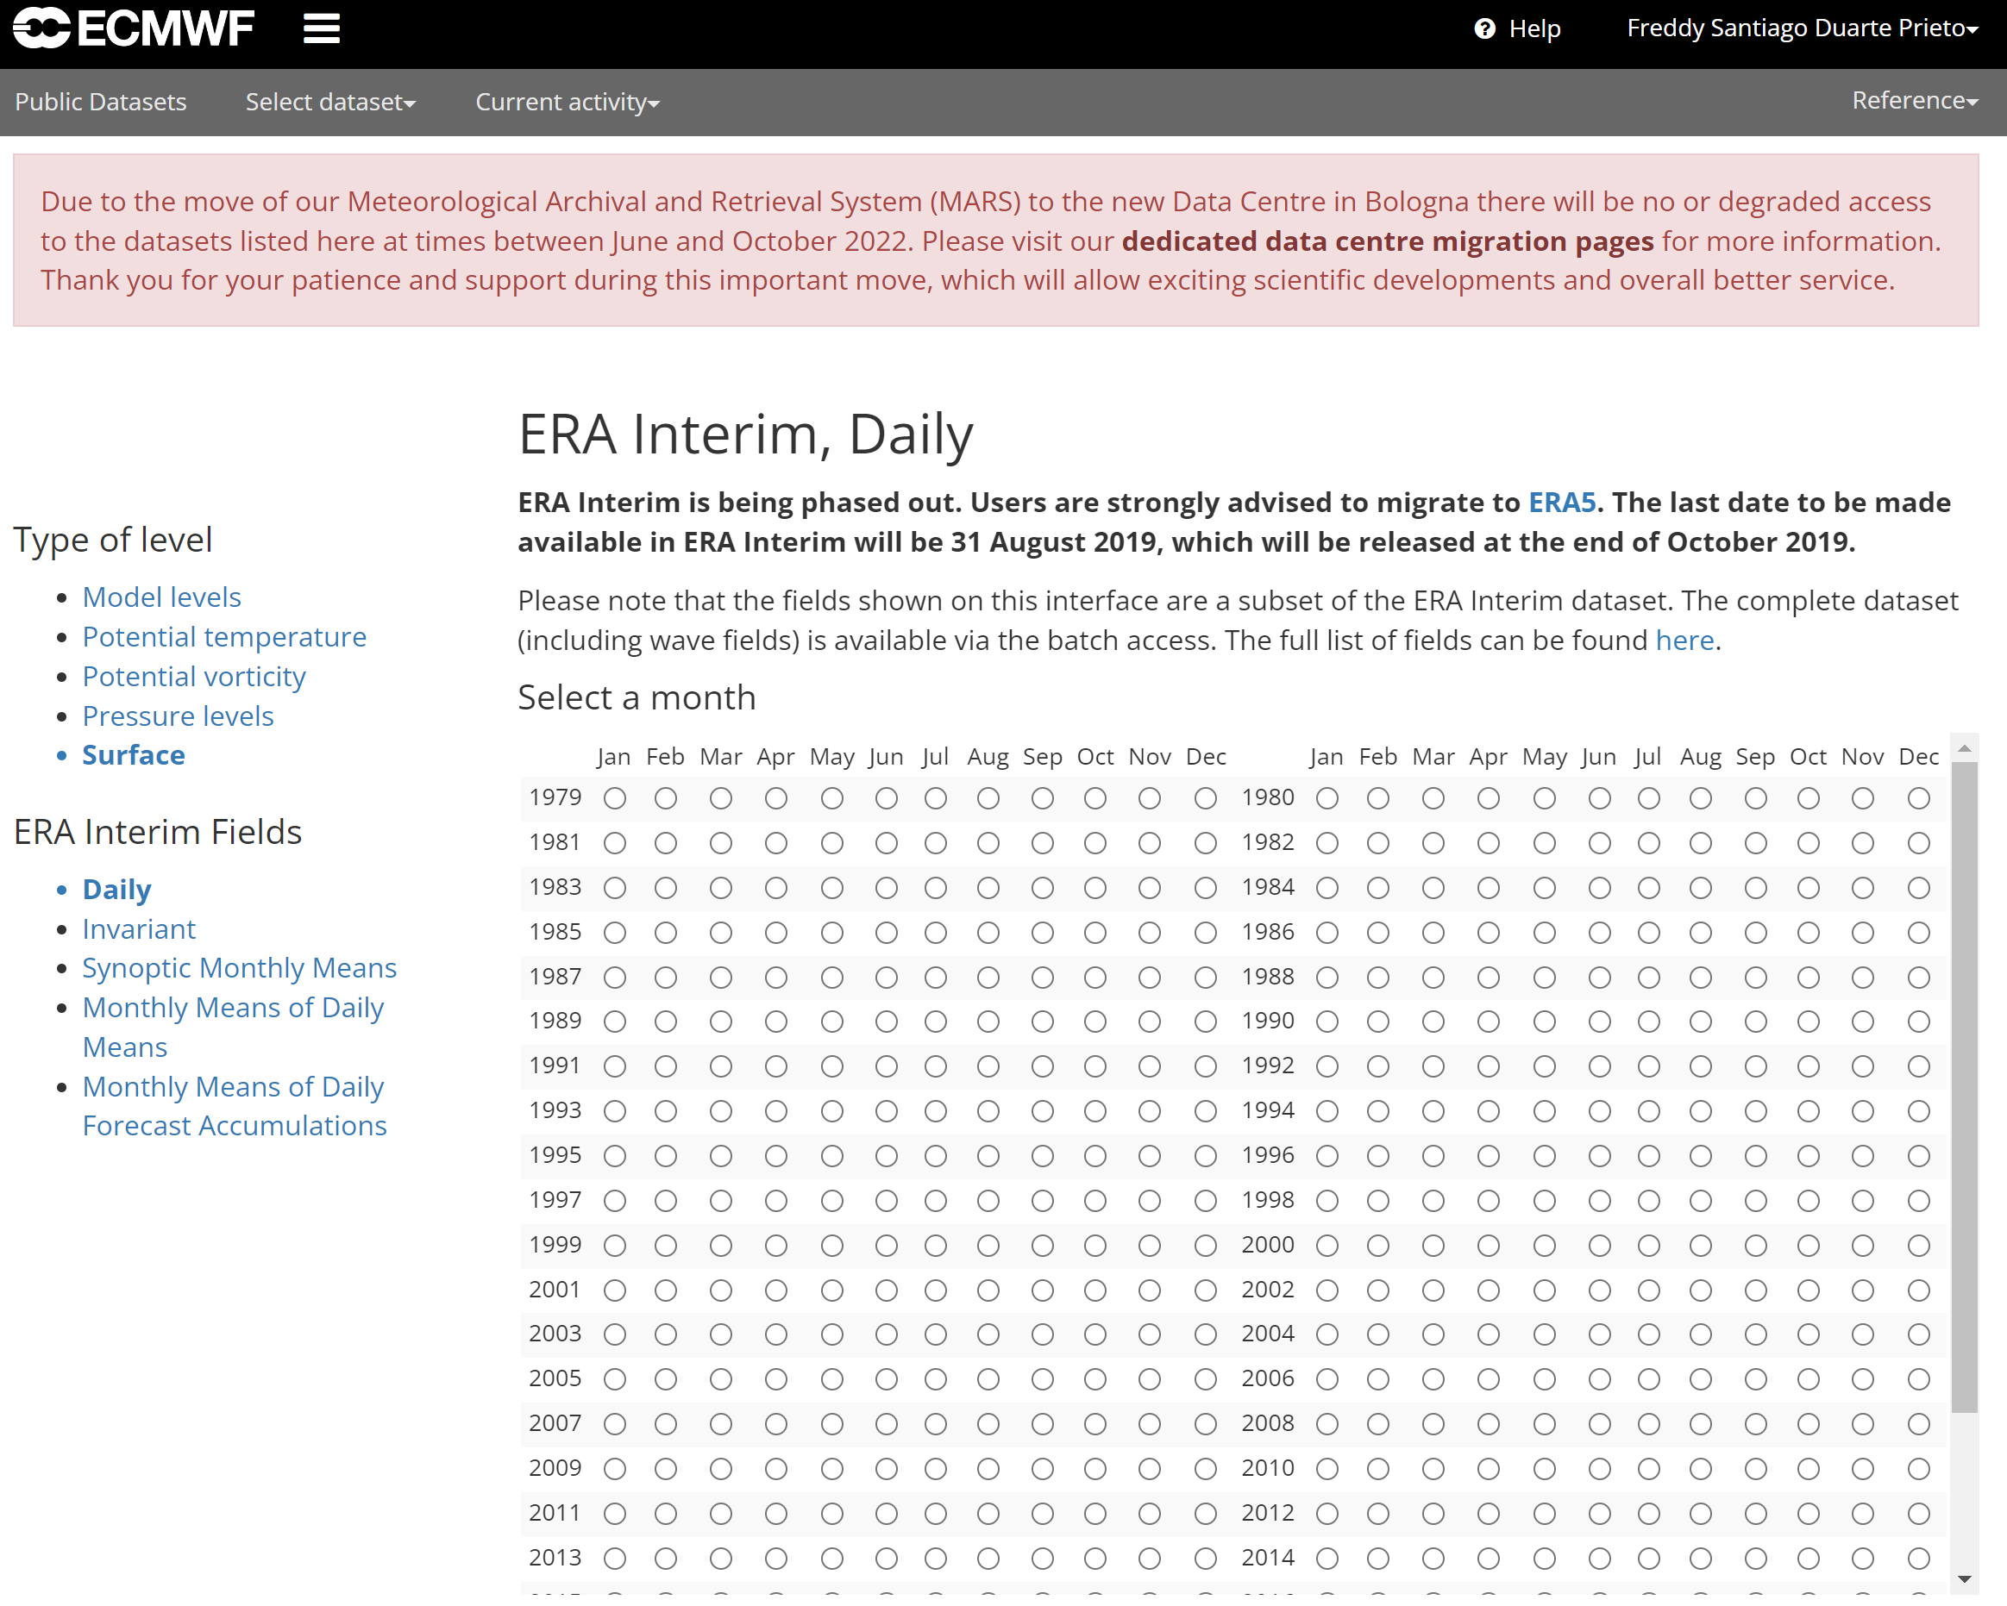
ECMFW ERA interim

Slide 23
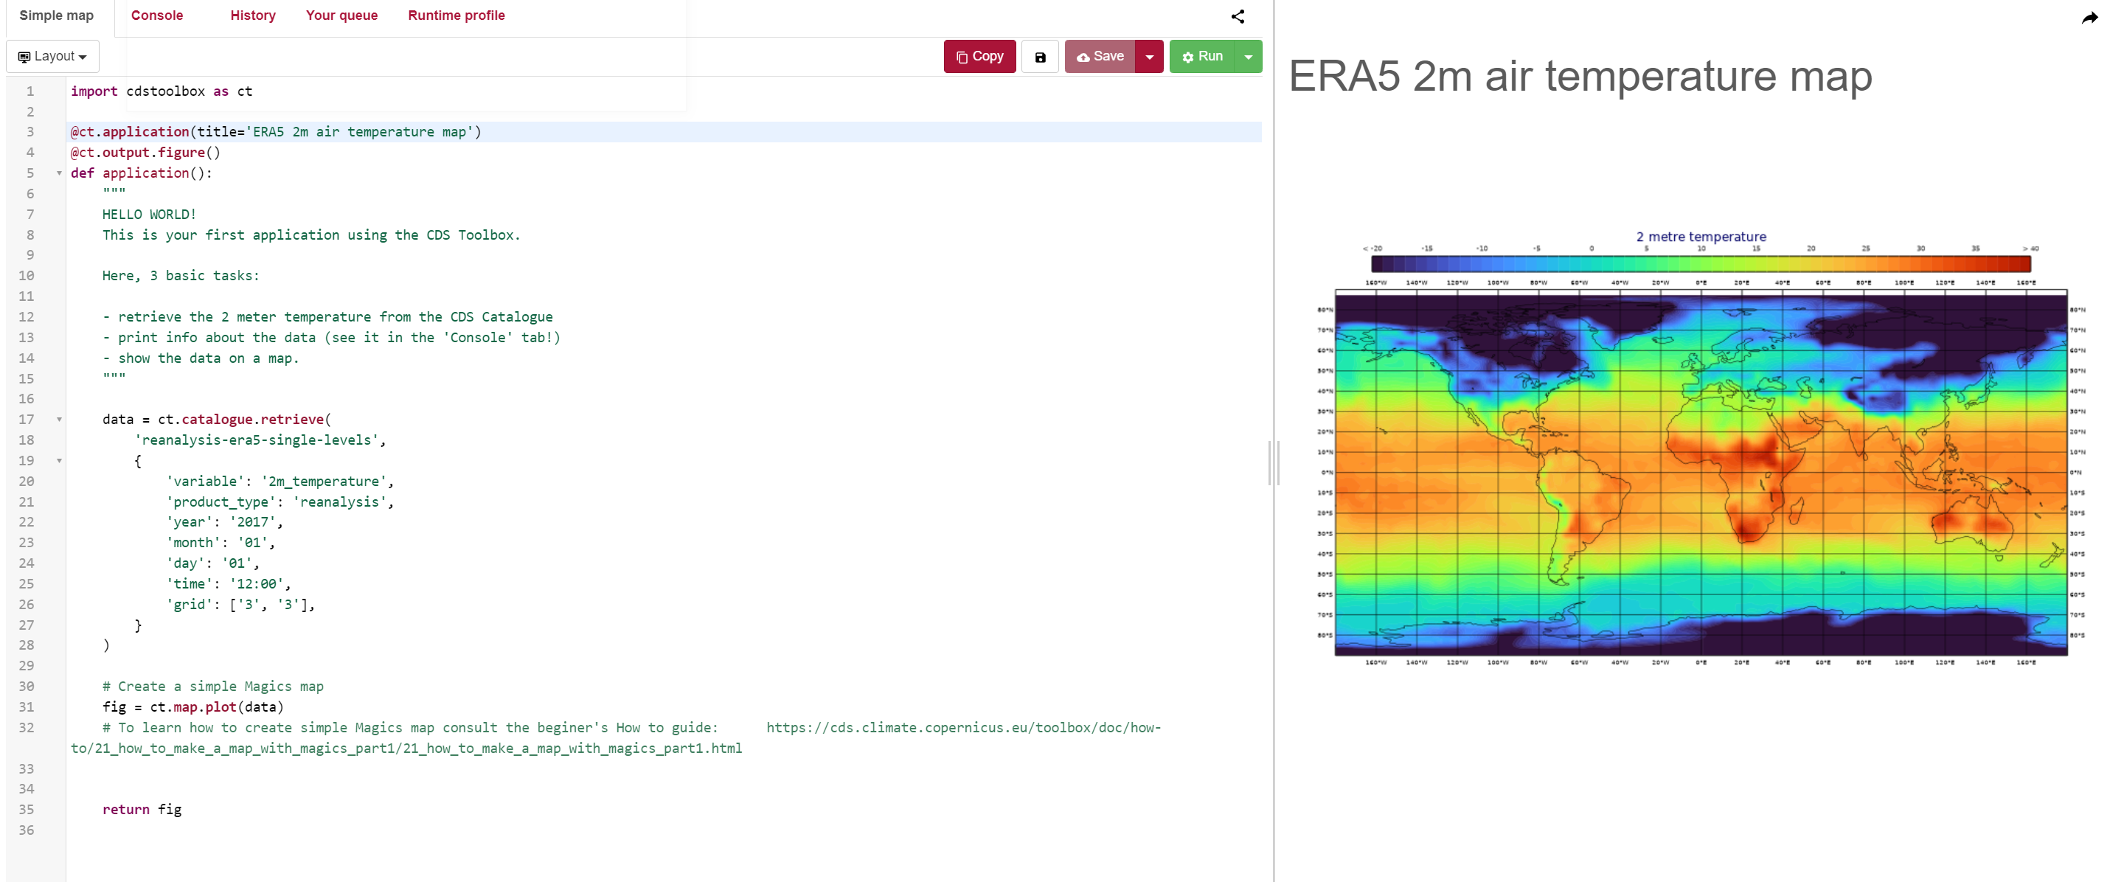
Copernicus (Climate Data Store)

